Slide 1
TIS Solutions Appraisal Systems

Slide 2
Contents
What is an appraisal system.
Description
Flow Chart
Tables
Snippets From the code
Output

Slide 3
What is an appraisal system:
Appraisal systems measure employee performance against previously-agreed goals, set future objectives and give staff guidance on their developmental and training needs. They help managers identify both achievements and shortfalls in performance, and give a framework to guide future improvements.
Employee appraisal refers to a program to assess employee performance. It assesses how effective an employee is in their current role in relation to pre-set criteria and targets. Also known as performance appraisal, performance review, or performance evaluation.

Slide 4
DESCRIPTION:
TIS Solutions has great work with their employees, with this in TIS Solutions they have increasing number of employees.
TIS solutions has a conflict about the employees and their accomplishments. It will implement appraisal strategies to keep
the motivational and performance level of their employees high. So, they want to implement this Appraisal System.
In the Employee Appraisal app all employees can know their performance with employee appraisal app. This performance can
be given in yearly, half-yearly, or quarterly to their employees. This will help the employees to grow up and enhance
skills with appraisal. This Appraisal module allows you to create top-down or bottom-up evaluation plans and give timely
feedback and compliments for accomplishments. By knowing all their performances employees will know all their.

Slide 5
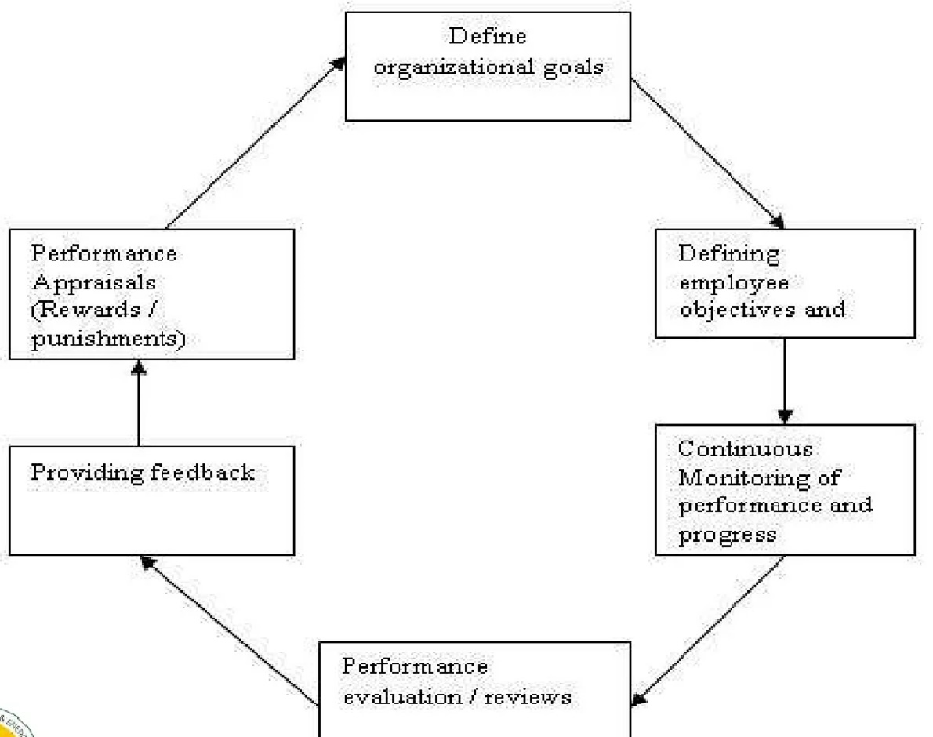
Flow Chart :

Slide 6
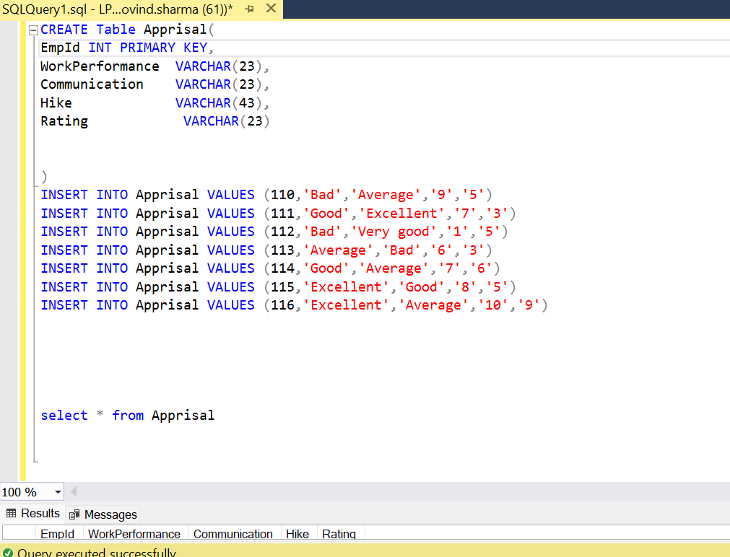
TABLE:

Slide 7
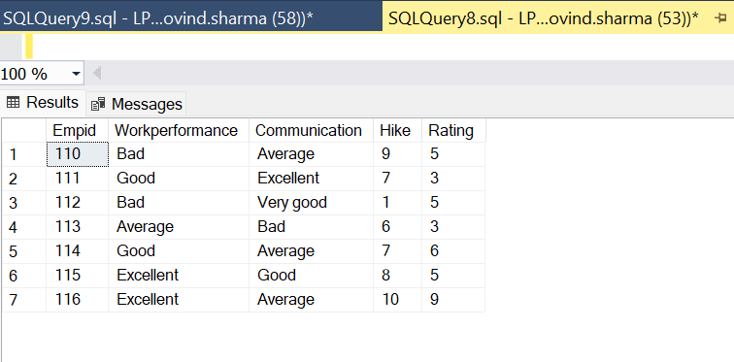
Output :

Slide 8
THANK YOU

